Slide 1
Medium-Sized Routed Network Construction
Implementing VLSM

Slide 2
Subnetting Review
To identify subnets, you will “borrow” bits from the host ID portion of the IP address:
  The number of subnets available depends on the number of bits borrowed.
    The available number of subnets = 2^{s}, I which s is the number of bits borrowed.
  The number of hosts per subnet available depends upon the number of host ID bits not borrowed.
    The available number of hosts per subnet = 2^{h} -2, in which h is the number of host bits not borrowed.
    One address is reserved as the network address.
    One address is reserved as the broadcast address.

Slide 3
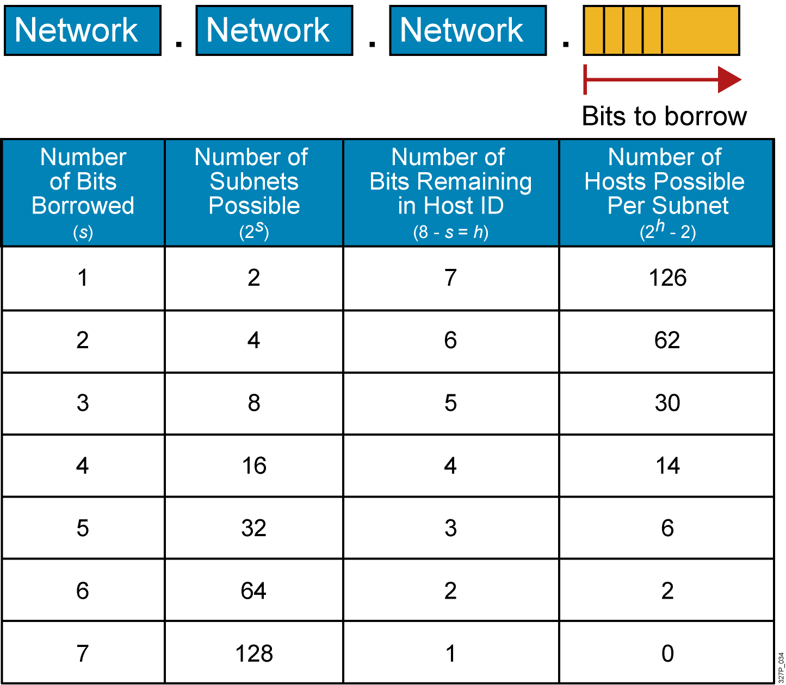
Possible Subnets and Hosts for a
Class C Network

Slide 4
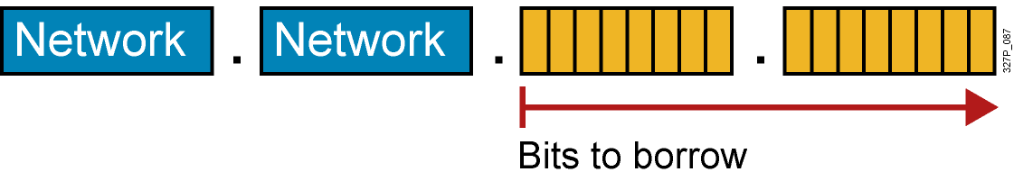
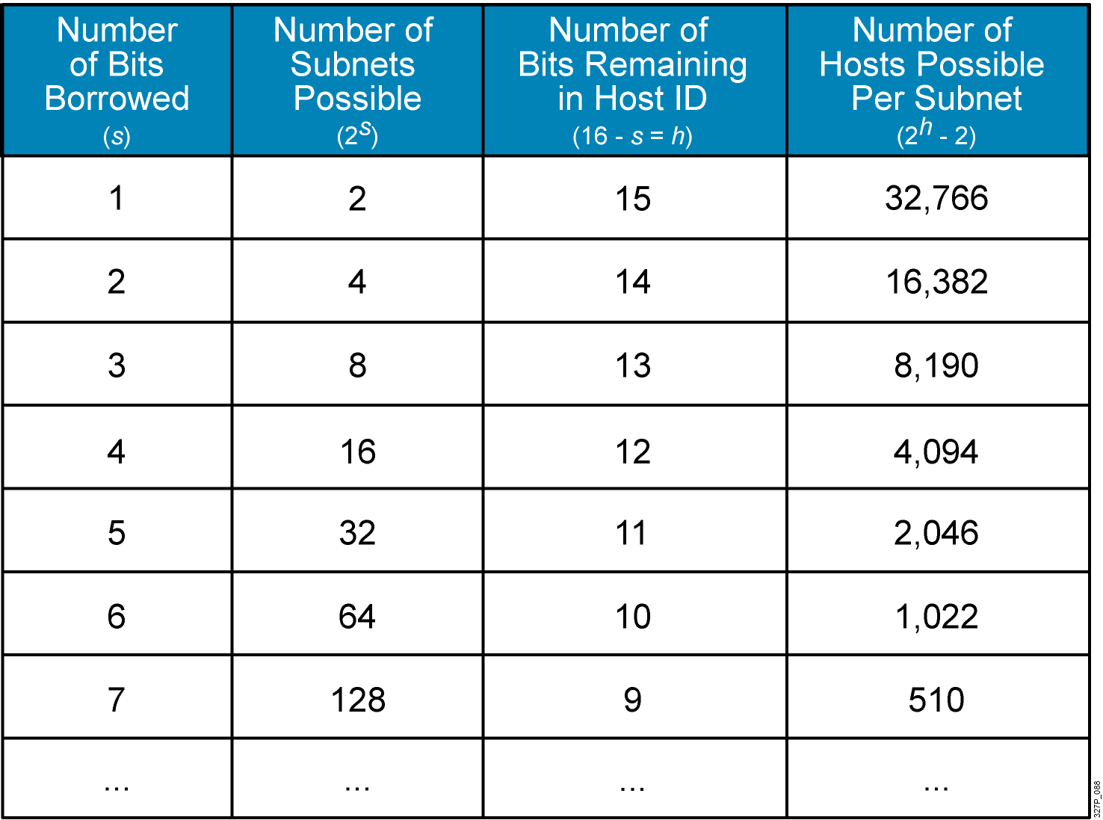
Possible Subnets and Hosts for a
Class B Network

Slide 5
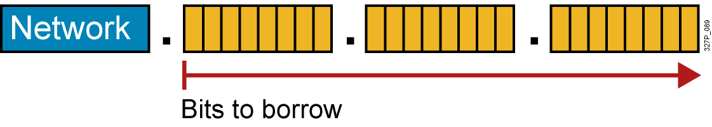
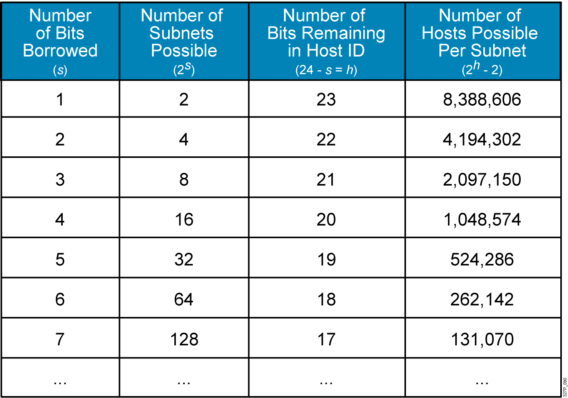
Possible Subnets and Hosts for a Class A Network

Slide 6
Subnetting Review Exercise
Subnet a network with a private network address of 172.16.0.0./16 so that it provides 100 subnets and maximizes the number of host addresses for each subnet.
  How many bits will need to be borrowed?
  What is the new subnet mask?
  What are the first four subnets?
  What are the range of host addresses for the four subnets?

Slide 7
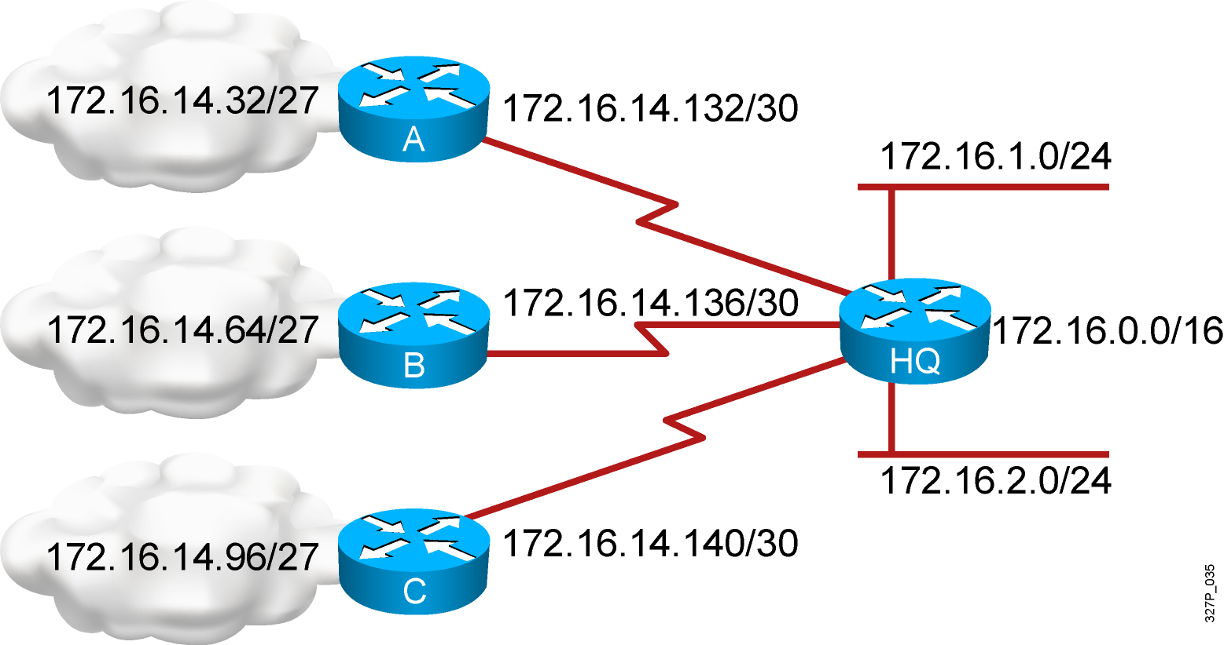
What Is a Variable-Length Subnet Mask?
Subnet 172.16.14.0/24 is divided into smaller subnets.
    Subnet with one mask (/27).
    Then further subnet one of the unused /27 subnets into multiple /30 subnets.

Slide 8
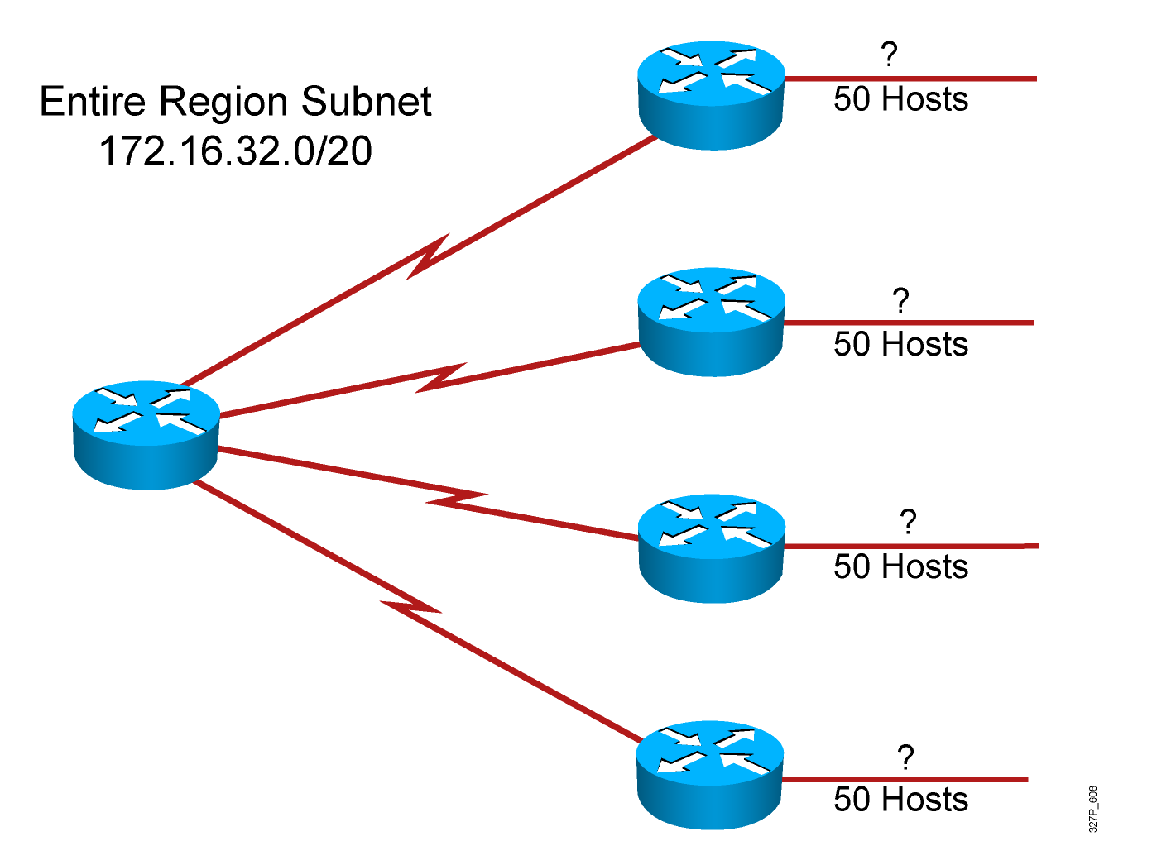
A Working VLSM Example

Slide 9
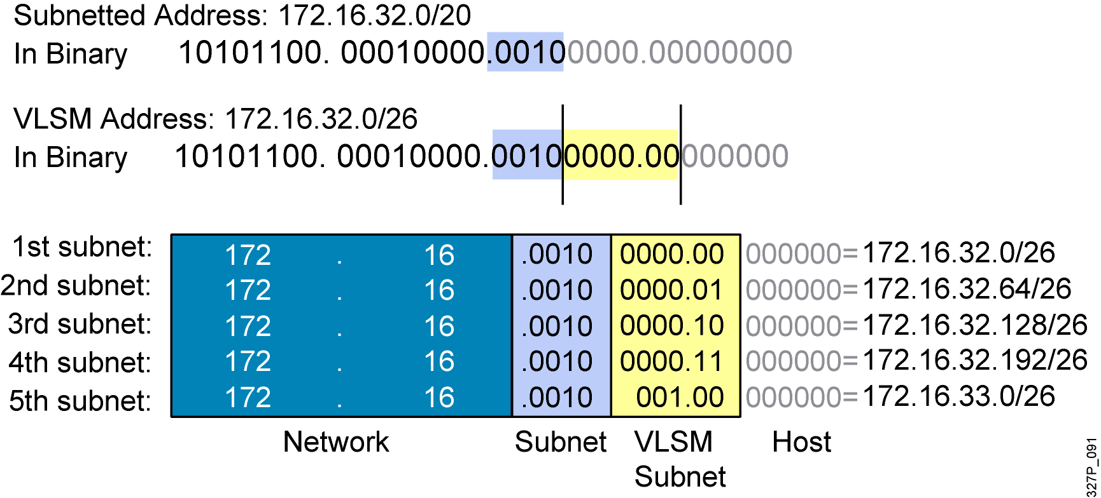
A Working VLSM Example (Cont.)

Slide 10
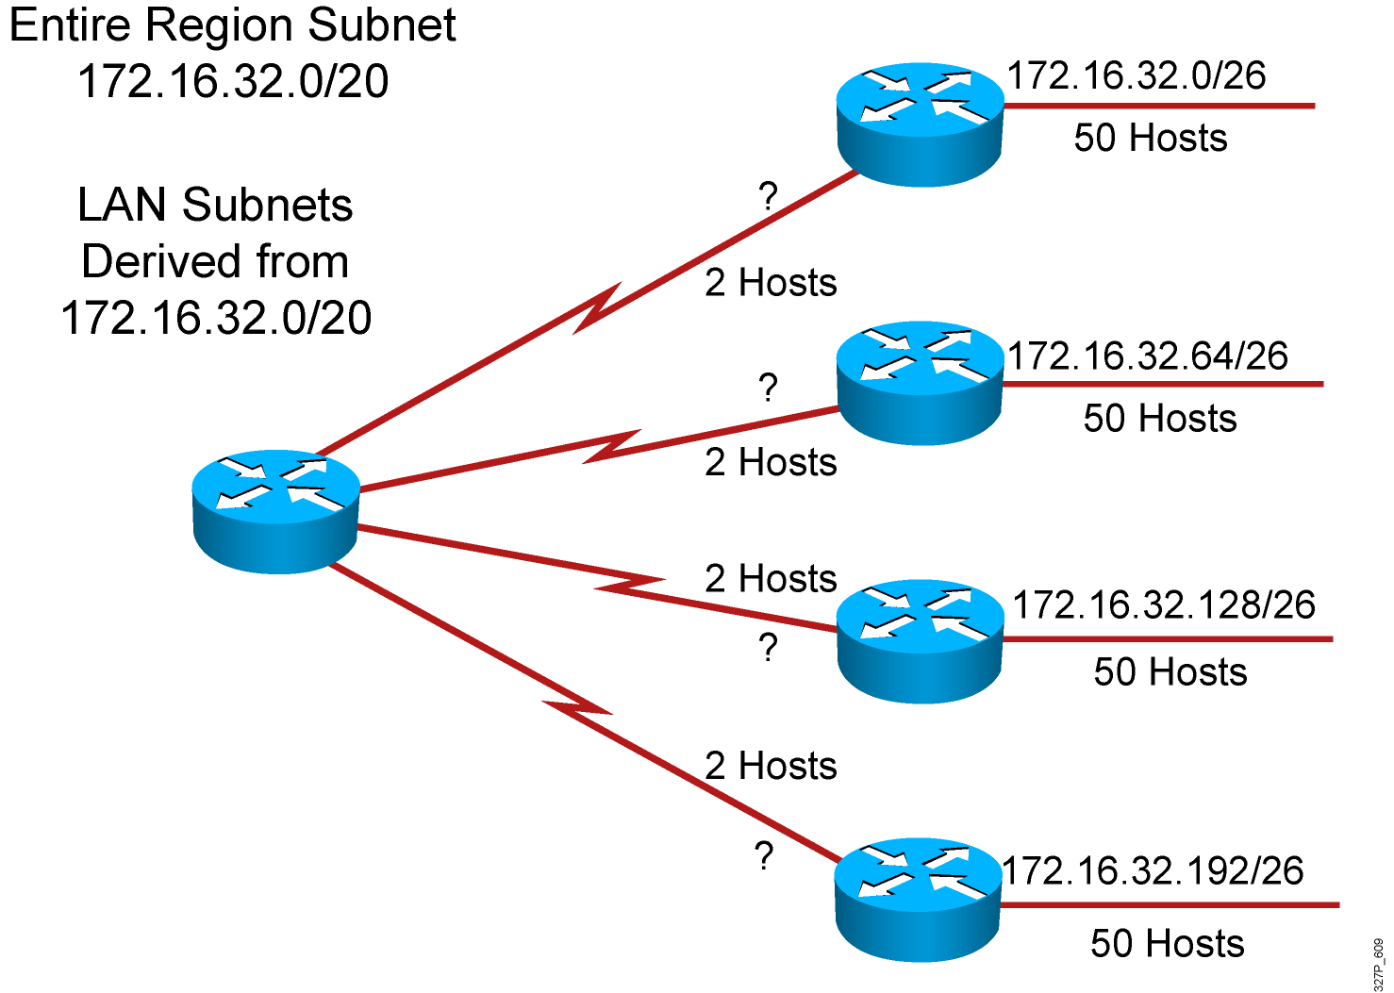
A Working VLSM Example (Cont.)

Slide 11
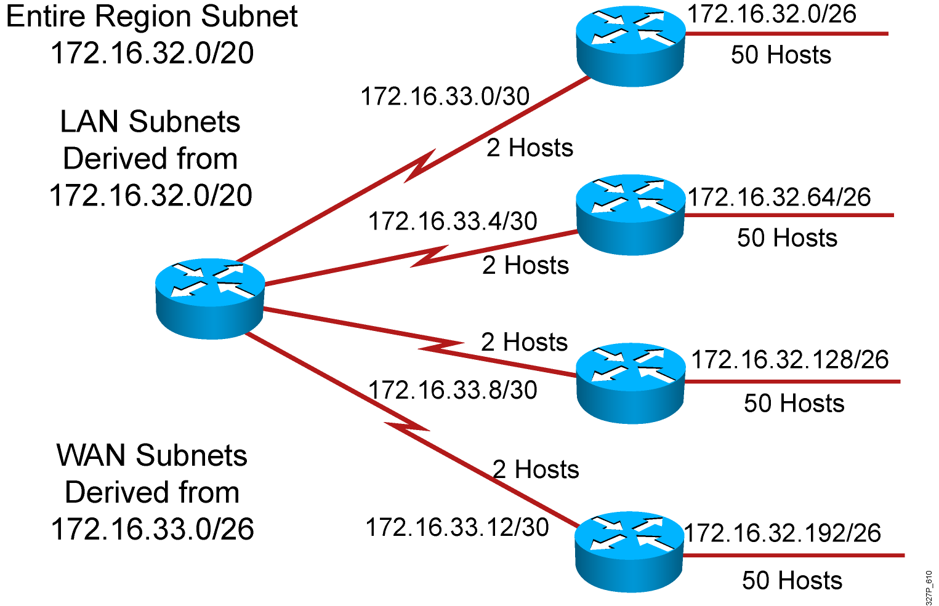
A Working VLSM Example (Cont.)

Slide 12
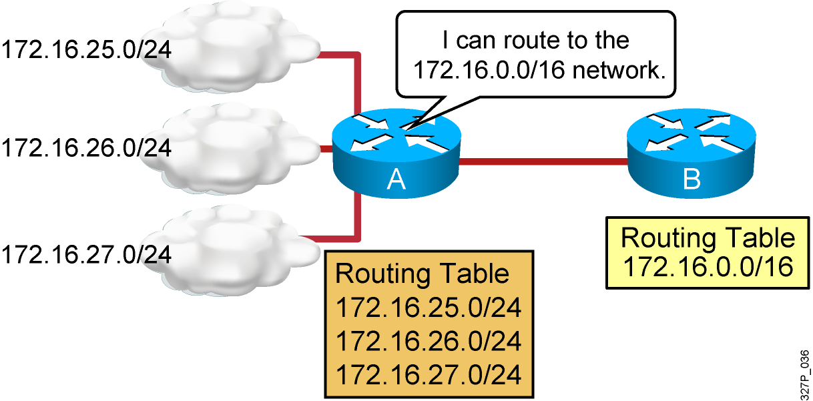
Understanding Route Summarization
Routing protocols can summarize addresses
of several networks into one address.

Slide 13
Classful Routing Overview
  Classful routing protocols do not include the subnet mask with the network in the routing advertisement.
  Within the same network, consistency of the subnet masks is assumed, one subnet mask for the entire network.
  Summary routes are exchanged between foreign networks.
  Examples of classful routing protocols include:
    RIPv1
    IGRP
Note: Classful routing protocols are legacy routing protocols typically used to address compatibility issues. RIP version 1 and Interior Gateway Routing Protocol (IGRP) are introduced to provide examples.

Slide 14
Classless Routing Overview
  Classless routing protocols include the subnet mask with the network in the advertisement.
  Classless routing protocols support VLSM; one network can have multiple masks.
  Summary routes must be manually controlled within the network.
  Examples of classless routing protocols include:
    RIPv2
    EIGRP
    OSPF
  RIPv2 and EIGRP act classful by default, and summary routes are exchanged between foreign networks.
    The no auto-summary command forces these protocols to behave as if they are classless.

Slide 15
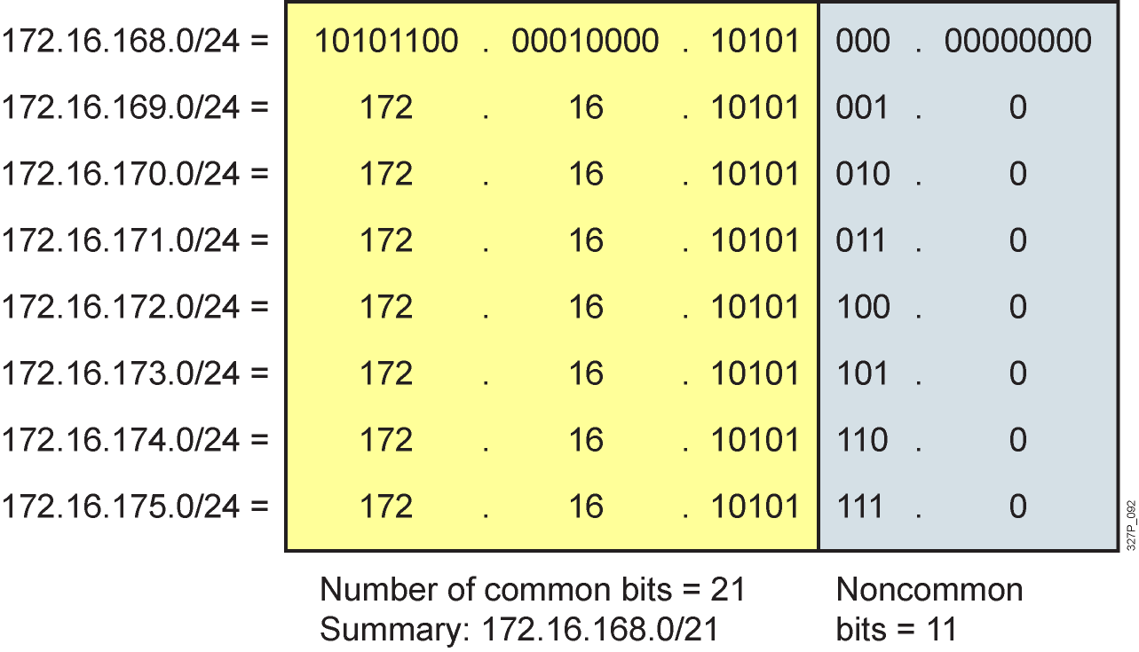
Summarizing Within an Octet

Slide 16
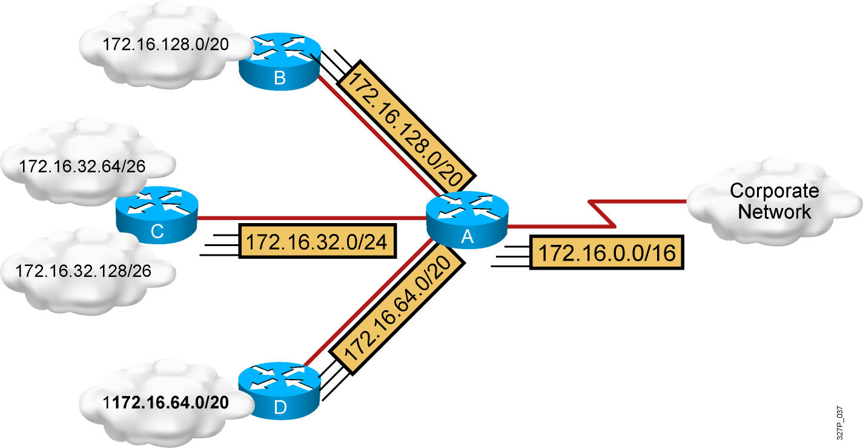
Summarizing Addresses in a
VLSM-Designed Network

Slide 17
Route Summarization Operation in
Cisco Routers
192.16.5.33 /32 Host
192.16.5.32 /27 Subnet
192.16.5.0 /24 Network
192.16.0.0 /16 Block of Networks
0.0.0.0 /0 Default
Supports host-specific routes, blocks of networks,
and default routes
Routers use longest prefix match

Slide 18
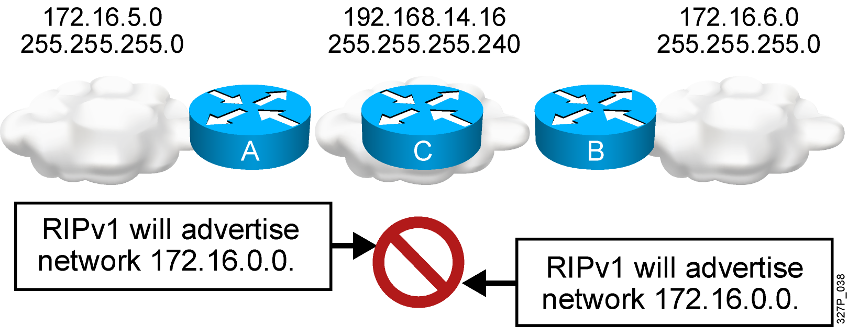
Summarizing Routes in a
Discontiguous Network
Classful RIPv1 and IGRP do not advertise subnets,
and therefore cannot support discontiguous subnets.
Classless OSPF, EIGRP, and RIPv2 can advertise subnets,
and therefore can support discontiguous subnets.

Slide 19
Summary
  Subnetting lets you efficiently allocate addresses by taking one large broadcast domain and breaking it up into smaller more manageable broadcast domains.
  VLSMs let you more efficiently allocate IP addresses by adding multiple layers of the addressing hierarchy.
  The benefits of route summarization include smaller routing tables and the ability to isolate topology changes.

